Slide 1
End of Year Briefing
Academic Year 2017-2018
Entire Brief is UNCLASSIFIED

Slide 2
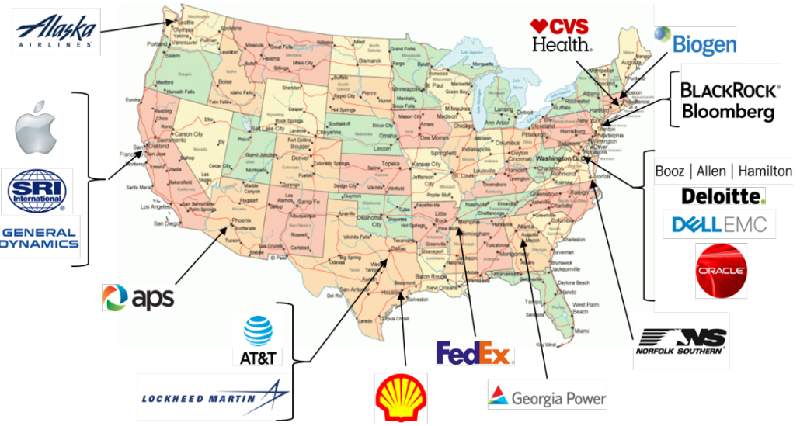
AY 17-18 Program Overview

Slide 3
SDEF – The Why…
Established by SECDEF as a long-term investment in transforming DoD forces and capabilities
Opportunity for DoD to gain access to executive level business practices inside highly successful corporations
Strategic Planning - Organizational Structures
Change Management - Human Resources
Information Technology - Supply Chain
Businesses outside DoD successful in:
Adapting to changing global environment
Exploiting information revolution
Structural reshaping/reorganizing
Developing innovative processes
Reforms can generate Defense Budget Savings

Slide 4
SDEF - The How
Two or more military officers from each Service
O-5 or O-6
Flag/general officer potential
Senior Service College credit for Army/Air Force/USMC
DoD Civilian GS14/15 Employees beginning FY17
Initial group education month
Current political/military issues; leading edge technologies
Meetings with senior DoD officials, business executives, press, alumni
Tailored Graduate Business school Executive Education
Eleven months at Corporate Sponsors
Each Fellow also visits ~7 other sponsor corporations to learn strategies, struggles, and best practices across multiple industries
Administrative
OUSD(P&R) Force Education & Training since FY17

Slide 5
SDEF - The Results
Continued demand from Corporate Sponsors
More Sponsors than Fellows available
Education³
DoD, Individual officers, Corporate Sponsors
Intra-group experience sharing; fresh perspectives for all parties involved
A cadre of military leaders who:
Understand more than the Profession of Arms
Understand business culture & varied corporate decision making processes
Recognize organizational and operational opportunities
Understand skills required to implement change
Will motivate innovative changes throughout career
Briefings to Senior DoD civilian / military leaders
DEPSECDEF, VCJCS, Service Secretaries/Chiefs
Deputies for Programs, Budgets, Acquisitions, T&E, Personnel, IT, etc.
Group corporate experience observations and recommendations for DoD

Slide 6
AY 17-18 Common Take-aways
Digital Transformation
Commercial Viability
Defense Industry IR&D
Corporate Emphasis on Focus
Bureaucratic Inertia
Safety Culture
Human Capital Management
SDEF Program Opportunities

Slide 7
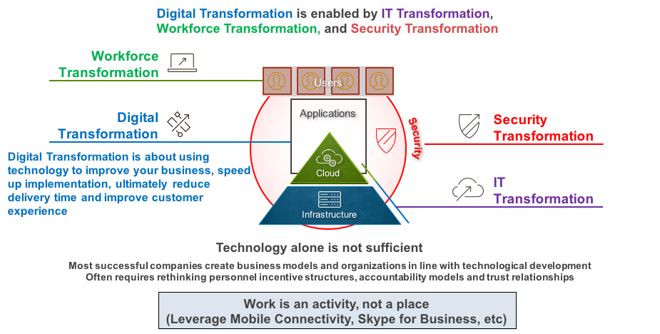
Digital Transformation

Slide 8
Invest/Acquire with Commercial Viability in Mind
US economic engine is strong; continuously producing new value
Examine commercial viability of technology during program development
A key part of acquisition strategy
GPS is a great example of economic benefit from government investment
DIUx model is a solid starting point
Prioritize commercial viability (to the maximum extent possible)
Acquisition strategies to gain disproportionate returns on investment
Key to successful Public/Private Partnerships
Promotes self-sustaining industry base and avoids lock-in
Encourages corporate R&D spending
DoD Can Should Both Leverage and Promote Industry

Slide 9
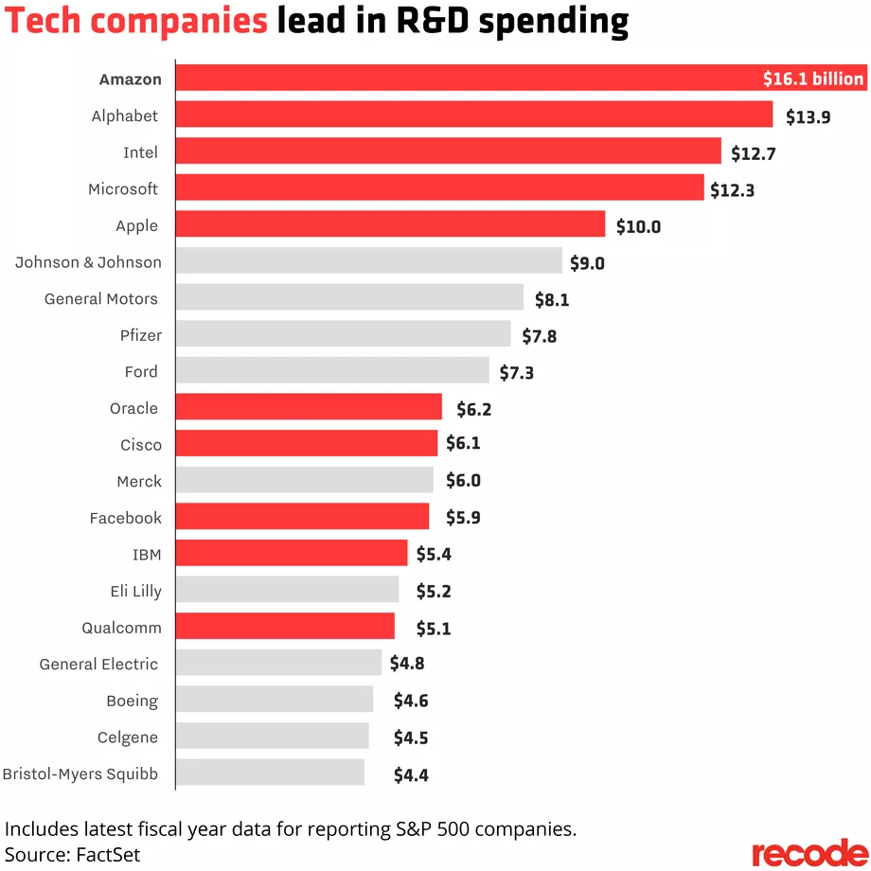
Defense Contractor IR&D Spending - Insufficient
Defense contractor R&D spending well below innovating companies
Too tightly coupled to government direction
Innovation primarily focused on cost cutting... not best value / little technology exploration
2017 data (R&D % / Annual Revenue / R&D)
Boeing: 3.4% / $93B $3.2B Raytheon: 2.9% / $25B $0.7B
NG: 2.5% / $26B $0.7B Lockheed: 2.4% / $51B $1.3B
Gen Dyn: 1.7% / $31B $0.5B
Amazon: 12.7% / $178B $16.1B Alphabet: 15.0% / $111B $13.9B Intel: 21.0% / $63B $12.7B Microsoft: 14.5% / $90B $12.3B Apple: 5.0% / $229B $10.0B
$6.4B
$71.4B
1 Sep 17

Slide 10
Say No - Stopping & Divesting
Significant corporate emphasis on “Focus”
Companies have clear understanding of Core Competencies
Core Competencies come with dedicated/deliberate investment
Companies willing to:
Stop executing a program (even good programs)
Not invest in good programs to stay focused on great programs
Must recognize and measure true costs and opportunity costs
Enterprise cost of decisions
Better Cost Accounting
Comparative Return on Investment Options
Imagine a “clean whiteboard”
If you started fresh today, is this the org/program/approach you would take?
If not, then pivot!
Avoid the “Sunk Cost” trap

Slide 11
Bureaucratic Inertia
Big beats small has evolved to fast beats slow
Must shrink the OODA Loop (Requirements, Engineering, Contracting)
Aggregate of Bureaucratic Inertia is crippling the defense budget
Defense industry bureaucracy mirrors DoD’s bureaucracy (2X) Opportunity cost:
3% Saving in Navy Procurement accounts would allow the purchase of 1 additional DDG-51 per year
3% Savings in Air Force Procurement accounts = $1.5B (18 F-35A $80M/Aircraft)
Fallacy that process improvement will yield required outcomes
Common belief that if we just get better at the current process, we will succeed
Structural changes are required
Eliminate/reduce low ROI tasks: “If it adds cost/schedule does it add value?”
Risk is not binary, must set risk at appropriate level and empower decision making lower in the organization
Must stop operating on the far right of the cost curve
Cultural shift from “Gatekeeper” to “Facilitator”
Deliver capability to the warfighter

Slide 12
Corporate Safety Culture
Corporation view safety as a behavioral design
The overriding priority, corporate value, and social responsibility. Not compromised.
Best safety cultures usually, yield best operating companies. Measured in terms of P&L
Increased focus on attention to detail
Emphasize safety of personnel and equipment over competing goals/interests
Leverage data analytics to improve the safety operations, with knowledge that was previously unimaginable
DoD Approach to Safety
Tends to be reactive in some enclaves/communities
Not holistically integrated or prioritized with operations and maintenance (USMC AGM Study)
Regulatory requirement vs a flexible process adapted to a unique mission
A new DoD Perspective on Safety
Adopt corporate approach to safety. Both personal and process focused.
Target mid-level managers, service members. Those who know/advocate work-around's.
Leverage a problem solving methodology to enhance the safety awareness/training
Create incentives for safety performance. Shift from a “want-to” rather than a “have-to” mentality
Benchmark with other industries (i.e. nuclear safety, safety, transportation)

Slide 13
Human Analytics / Talent Management
Innovative, extraordinary results come from innovative, extraordinary people; top firms:
Place top leaders in HR / integrate HR as business unit partners
Hire top 1-2% of massive candidate pools (>2M applications/yr at Google)
Innovation requires diversity of thought, think beyond demographics
Extreme selectivity in hiring allows for:
Negligible levels of bureaucracy (regulations & instructions)
Negligible levels of mandatory training
Unlikely to effect desired transformation without right people; recommend:
Drive to increase size of applicant pools
Screen for right people with latest in field of People Analytics
Leverage data throughout talent management lifecycle
Focus OSD & Services’ People Analytics offices on quality vs. quantity

Slide 14
Talent Management... Fellowship
The SDEF itself offers great opportunity to execute lessons learned
DoD & Services better optimizing the program’s effectiveness
Synchronize Service’s current and future challenges with the fellows’ assignments to their specific companies
Placing fellows at/near executive level of their host company
Have Services engage with the fellow periodically during fellowship for focused updates, and mentorship
Maximizing DoD’s Return on Investment limit
Proactively manage fellowship talent to ensure follow-on billets leverage the experience gained during the program
Purposely assign fellows to billets to address current and future DoD & Service challenges vice current passive ROI

Slide 15
Individual Fellow Take-aways

Slide 16
Observations & Recommendations
Observations
Ready, Safe, Go
Safety is the #1 consideration
Safety Core Value, Safe branding, Safety awards, Metrics/Indicators
Communication
Alaska’s World
Smartphone Apps (Pulse)
Webcasts
Leadership Development Programs
Continuous development of leaders at junior, mid, and senior levels
Sustainability/Fuel Efficiency
Added winglets/split winglets at heavy checks (2-3 weeks downtime)
20 MM gallons annual fuel savings (4.5% savings for split winglets)
Recommendations
Leverage smartphone apps (like Pulse) to communicate
Look for fuel efficiency opportunities as we retrofit older aircraft
Incentives for recruitment/retention of talented civilians

Slide 17
Observations and Recommendations
Strengths:
Innovation: Innovative product lineup - Innovate or die is true of products, processes, tools
Brand: Fierce focus on brand and customer experience (drives innovation in the channels Apple is sold through. Apple is the only brand that can be sold in Walmart and Hermes.)
Collaboration: Highly collaborative environment based on functional departments
Data Analytics: Robust understanding of big data environment and how to measure specific variables WRT revenue and sales force engagement
People: Attract, recruit, train, and retain high performing leaders/employees; Compensation (even part-time hourly employees get stock compensation); Career Experience (CE) programs for employees to experience other short term career duties/jobs
Challenges:
Winner’s Curse: Apple is confronted by aggressive competition in all areas of its business. Not limited to competitors’ products or sabotaging through press, also must manage customer expectations increasing every year
Maintaining an entrepreneurial feel and innovation in their DNA as a multibillion $ business (Apple University)
Recommendations
Data Analytics - Define success, develop key performance indicators (KPI’s) that accurately measure “success”, and invest in data analytics across all spectrums of warfare to establish a baseline. (OPNAV NAO/N09X is a great start!)
Develop a culture of measurement - Knowing what KPIs are important, understanding what will be measured and knowing how to influence those measurements
Implement incentives/programs to retain high performing leaders/ employees (commensurate with public sector for key career fields)

Slide 18
Observations & Recommendations
Observations (PVGS)
Safety Culture
Safety as a value
Environment for raising concerns
Safety Conscious Work Environment (SCWE)
Price of Admission Tools
Leadership and Employee Engagement
Every employee is a leader, regardless of title or position
Pride and Dedication; life-long multi-generational employees
Knowledge and Training
Continuous learning organization: sharing knowledge is fundamental
Communication is key
Recommendations
Adopting the nuclear safety culture
PVGS safety as a model: standards and expectations
Executive MBA should accompany the program

Slide 19
Observations & Recommendations
Observations
Focus on retraining (MOOCs, Nanodegrees, technical MS programs)
Changing to a data-powered insight framework
Aggressively automating business processes
Centralized Chief Data Office
“Starving” core network business of capital to underwrite the Time Warner merger (i.e. throttle next gen technology for new advertising revenue)
Recommendations for DoD
Use industry educational technology for training
Drive data centered decision making from the top down
Ensure analytics / analysts are at ALL levels of the organization
Upgrade network infrastructure to remain fiscally “competitive”
Reexamine communication systems certification and accreditation to rapidly field new network technology (SDN, SDWAN)

Slide 20
Observations & Recommendations
Observations
Information Technology: a significant benefit IF use is disciplined and consistent
Supports the competitive necessity of data driven decision making.
Modern Workplace: 9-5 at the same brick and mortar location is outdated/inefficient
Modern Technology & paradigm shift of “goal focused” work vice “hours” worked
Virtual meetings, etc. from home/airport/hotels gives flexibility to work/life balance
Allows maximum & diverse talent recruitment worldwide
Biopharma industry employees: highly intelligent & collaborative, but…
Lack Leadership, confidence, project management to drive initiatives forward
Recommendations
Embrace the most modern IT solutions, outsource to the best
Use secure servers only where truly necessary
Explore modernization of work atmosphere and rules for DoD
Attract a broader range of potential employees
Reduced workforce “hoteling” equals savings
DOD Leadership training is significant, strong, and sought by industry
Use to recruit talent into DoD)

Slide 21
Observations & Recommendations
Observations
Success rooted in HR: 330K job apps for 2.5K positions annually, .75% hire rate
Virtually no training compared w/DoD: Employees “just figure it out”
Leveraging data analytics/AI across HR functions
Senior leader focus on founders culture, performance, innovation, cost control
Rapid growth via M&A; grappling with “staying small” while institutionalizing
Tech emphasis: Goal of 30% of revenue from tech by 2020
Robotic process automation for everything routine
Aladdin backbone: Data gets one location → min duplication, common picture
Recommendations
Build culture of innovation through concrete management changes
Data-based management, appreciate well-intentioned failure, inculcate inclusion
Study all aspects of officer accession methodologies
Goal: Commission most capable citizens; does current framework support goal?
Fortify DoD people analytics (71% of firms prioritizing) → quality vs. quantity
Refine targeting of recruiting efforts → bring in top talent
Organizational network analysis → drive targeted retention
Leverage multidisciplinary data → could have predicted pilot attrition?
Leverage data to understand engagement → drive member performance

Slide 22
Observations and Recommendations
Bloomberg L.P.
Observations
Culture
Operates a unique company wide culture that focus on “transparency”
Senior leaders have no offices and everyone works in a open bay layout
Conference rooms made of glass and all meetings are viewable to all
Collaboration between workers is highly encouraged to increase innovation
Organization Structure
Very flat. Senior leadership very accessible
Decisions, once made are executed with speed
Cyber Security
The number of daily attacks are significant and responses are very “defensive”
Have to assume some attacks will be succeed
MOE is how quickly mitigated
Recommendations
Technology
Uniquely developed Video teleconferencing (VT) system effectively used by all employees
A force multiplier that connects a global company on four continents
DoD reserves VT technology to GO/FO but should allow UNCLAS use by most members
An effective tool for meetings, collaboration, training
Data
Big data is used extensively to track company metrics
Financial data is sold as a commodity to other Fortune 500 companies
DoD/Services live in a sea of data but have not harnessed it yet for operational use

Slide 23
Observations & Recommendations
Observations
Overall: No longer mission support concept
Now embedded with the client (70%)
Overall: Project-based agile mentality
Overall: Extremely flexible framework
Includes integrated delivery, teleworking, hoteling, and other work arrangements
DOD Business: All focus in support of SEC Mattis guidance (05 Oct 17)
Cyber Business
If its something someone else can do I give away the business.
I’m only interested in what no one else can do.
That’s how I retain the talent
Recommendations
Engagement with Industry = #1 Frequency, #2 Transparency, #3 Consistency
Skype for Business on all computers = long term investment
New Army Futures Command must look at best industry operations practices
Headquarters and CFTs will likely not be in the same locations

Slide 24
Observations & Recommendations
Observations
Advanced digital innovation capabilities
Delivering digital tools to consumers in weeks, not years
Telehealth from smartphone or tablet
Driven to provide quality, accessible, convenient health services
Revamping store layouts, offering optometry and audiology
Soon to offer primary care
Focused on maintaining competitive advantage through transformation
Aetna acquisition, partnership with Kaiser
Recommendations
Explore opportunities to deliver convenient digital tools for DoD healthcare beneficiaries
Making an appointment or ordering a prescription refill from your smart phone
Explore partnership opportunities with enterprises like CVS Health
Offer convenient, quality health care options
Urgent care to active duty SMs after business hours

Slide 25
Observations & Recommendations
Observations
Premium placed on talent recruitment and development
Deloitte University
Milestone Training
Focused on diversity and inclusion to strengthen value to clients
Leadership relooking how the firm organizes to go to market
Greater emphasis on technology
Interested in growing the Federal practice
Recommendations
Talent Management & Development
Increase opportunities for DoD workforce to move between government and industry
Develop a more experienced and connected workforce
Better align utilization tours following training, internships, and fellowships (build a pipeline)
Innovation
Seek intuitive, ready to near-ready capabilities, adaptable to incremental upgrades
Request for Interaction vs. Request for Information with industry
Analyze how DoD will operate within the Industry 4.0’s nine pillars
Internet of things, simulation, additive manufacturing, cybersecurity, cloud storage
Big data and analytics, autonomous robots, augmented reality, and system integration

Slide 26
Observations & Recommendations
Observations
Highly mobile and interconnected workforce
“Work is not a place; Work is an activity.”
Customer obsessed – customer service & support is top priority
Relentless in reducing waste to improve business processes efficiency, supply chain and environmental
HR is committed to the talent acquisition war
Innovation is their life blood - Focused on digital transformation for themselves & customers
Limited business with Federal Govt ~5% of total revenue
Recommendations
Leverage & apply the R&D that tech companies are investing in innovations to DoD missions
Explore ways that DoD can increase the speed of digital adoption

Slide 27
Observations & Recommendations
Observations
Proud employee base and annual name on Fortune’s Most Admired List
Tax Cuts and Jobs Act impacts significant
Wage increases, pension funds, and expanded capital investments
Engaged executive leadership team
Mindful considerations to talent growth, turnover, succession
Recommendations
Explore safety activities
Self reporting, fatigue management, human performance
Explore additive manufacturing capabilities
Expected growth reflects company’s belief in long-term sector viability
Advances with in-transit visibility on packages is noteworthy

Slide 28
Observations & Recommendations
Observations
Broad experience and technical depth
Strong government, industry and international partnerships
World leaders in communications and networking tech of all kinds
Employee commitment... low-turnover/many multi-decade employees
Appealing to next generation... facilities improvements, internships
Dedication to the mission
Recommendations
Skype for Business is great
Competition good for industry, but must be used appropriately
Stability/Predictability can drive better value (acq strategy, rqmts)
Avoid CPAF-like management on FFP contracts (oversight & fee)
Current fiscal/regulator environment challenges innovation... companies often incentivized to cut costs rather than explore opportunities
Be as transparent as possible... Companies value customer engagement

Slide 29
Observations & Recommendations
Observations
Safety Culture
Actively Caring
Positive Reinforcement
Proactive Approach
Human Performance
Risk Assessment/Prevention
Customer Value
“A Citizen Wherever We Serve”
External Affairs
Economic Development
Influence Regulatory Impacts
Optimizing Energy Mix for a more efficient future
Reduction of Coal Power Plants – focus on gas, nuclear and renewables
Vogtle 3 & 4 Nuclear Reactor Expansion project
First nuclear reactor built in the U.S. in over 35 years
Recommendations
Continue to leverage 10 USC 2922a “Special Agreement Authority”
Keep a close eye on Small Modular Reactor Technology
Follow on payback tour at OSD ASD (EI&E) or Service equivalent

Slide 30
COOP and International Trade Compliance
Observation
Current Arms Export Control statutes, policy, and processes require modification
Allow the broader USG – Defense Industry partnership to realize significant cost savings
Eliminate non-value added work while still complying with the Arms Export Control Act (AECA)
COOP Programs promise to Reduce Total Life Cycle Costs
Shared cost of Development, Production, Operations, and Sustainment
F-35, P-8A, Next Generation Jammer, MQ-4C, SH-60R
Economies of scale significantly offset by costly and burdensome export bureaucracy
Bureaucracy only re-affirms a decision already made by the USG
Conclusion
Cooperative Defense Programs should have streamlined Export Control processes
Fully capture potential savings
Cooperative programs should receive NLT same benefits than Foreign Military Sales
Recommendation
Identify modifications to statute, rule, policy, and processes
Facilitate and streamline Cooperative Programs
Still comply with intent of the Arms Control Export Act and Export Administration Act

Slide 31
ITC - Notional Process
Typical Export Approval: 5d Best / 45d Average / 122d Worst
Export Requirement
Development
Production
Sustainment
Site Stand-Up
Spares
ALIS
Tech Data
Export
Method
License
UK - Defense Trade COOP Treaty
AUS - Defense Trade COOP Treaty
CAN- Strategic Trade Agreement
LM Aero
ITC
CCL
Department of Commerce
Approval
Congressional Notification
USML
Export Approval
Shipment Processed
Department of State
Directorate of Defense Trade Control (DDTC)
Approval
LM Corporate
ITC Review
Intent of Arms Export Control Act (AECA)
Affirm technology transfer authority
Tracking/custody of items
Valuation of export for trade balance calculations
Technical Review
License Content
Part Number (P/N)
Quantity
Price/Value
Modelers
Commercial Catalog
USML Determination
Signed Contract Number***
NSA
DoD/JPO?
DoE
Governance:
Depart of State – United States Munitions List (USML)
Arms Export Control Act 22 U.S.C. § 2778
Critical Military Technology – Military Use Only
Department of Commerce –Commerce Control List (CCL) and Export Administration Regulation (EAR)
Export Administration Act 50 U.S.C. §§ 2401-2420
Dual Use – Military and Civil
600 Series Military (Non-Critical Military Technology)
Industry
Government
Guidance

Slide 32
Observations & Recommendations
Observations
Strategic Plan delivering record economic performance
Focus on streamlined operations, enhanced customer service, and long-term shareholder value
Key metrics by 2020: <65% operating ratio, >$650M productivity savings, >10% EPS
Leveraging big data
Optimizing fuel efficiency and locomotive modernization programs
Right-sizing crew and labor force
Real-time visibility for customers via e-business and communication systems
“I am Coming Home”
Safety culture is a corporate, social and individual employee priority
Robust training program focused on safe behavior, rules compliance and risk reduction
Recommendations
Explore rail as post to port strategic transportation option
Leverage modernization, reliability, and fuel efficiency best practices
32
32
Notes:
32

Slide 33
Observations & Recommendations
Observations
Charismatic leaders drive company vision, loyalty, and productivity
Partnerships are vital to innovation and efficiency
Securing data is so much more than physical aspects
Recommendations
Partner with industry professionals whose primary mission is to
Innovate, update, maintain, and secure information technology
Apply a defense in-depth to secure the IT enterprise
Employ comprehensive data protection and layered controls
Data encryption
Encryption key management
Data masking and sub-setting
Privileged user access
Auditing and monitoring
Isolation and Remediation

Slide 34
Observations
Observations
Safety: “Goal Zero” safety culture is a tablestake in all Shell businesses
The first topic discussed at every meeting or gathering; ALWAYS!
Globally Connected: Shell is a virtually connected enterprise
Local and global teams work together seamlessly via Skype for Business
People: Annual Shell People Survey (SPS) enables an already engaged workforce
Provides feedback and direction on how the business is doing
Performance: Shell focuses heavily on knowing and understanding
Performance, costs, and how to optimize their end to end value chain
Challenges Shared with DoD
Long Term Strategy: Operates aging assets and struggles to find right balance
Investing in new technology or maintaining current infrastructure
New organizational structures
Sustainability: Embarking on an aggressive operational path
Socially and environmentally responsible ways
Designing for Future: Brilliant Basics, Accelerators, Innovation Funnel, Digital Roadmap
Implemented in an organization that is perceived to be slow to embrace change

Slide 35
Observations and Recommendations
Observations
Contract research as a small defense contractor a challenge
Overhead required to do business with the DoD results in higher costs to the government
Fast prototyping requirements
OT funding, co-located technology/operational experts, 3D printing
An ability to fail
Talent management in high demand fields will require DoD rethinking
Compensation and personnel structure (specifically in programming)
Recommendations (learned while in Silicon Valley)
DoD requires an Artificial Intelligence roadmap and significant investment NOW
A coherent basic R&D plan to more efficiently utilize the DoD’s R&D budget
Should DoD conduct basic research (6.1)?
Concur with CVS recommendation regarding smartphone healthcare
Stanford Health apps make it simple to correspond with the hospital staff
Ergonomics advisor to reduce costs

Slide 36
Organizational Model and Technology
Technology alone is not sufficient
Digital Transformation is about using technology to improve your business, speed up implementation, ultimately reduce delivery time and improve customer experience
Digital Transformation is enabled by IT Transformation, Workforce Transformation and Security Transformation
Most successful companies create business models and organizations in line with technological development
Often requires rethinking personnel incentive structures, accountability models and trust relationships
Work is an activity, not a place (Mobile Connectivity, Skype for Business, etc)

Slide 37
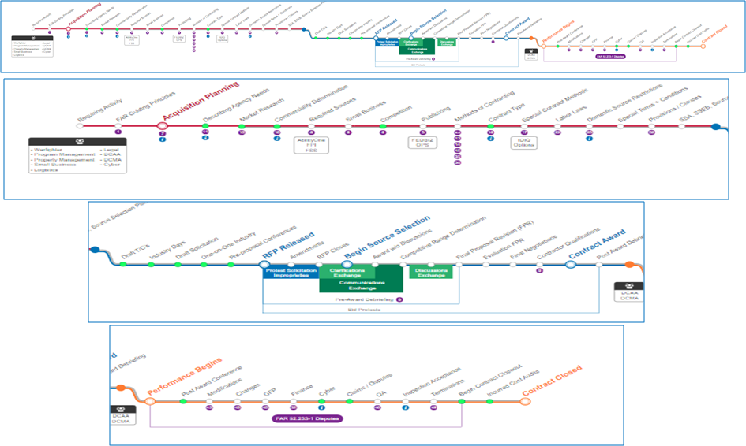
DAU Contracting Timeline

