Slide 1
End-Year Briefing
Academic Year 2019-2020

Slide 2
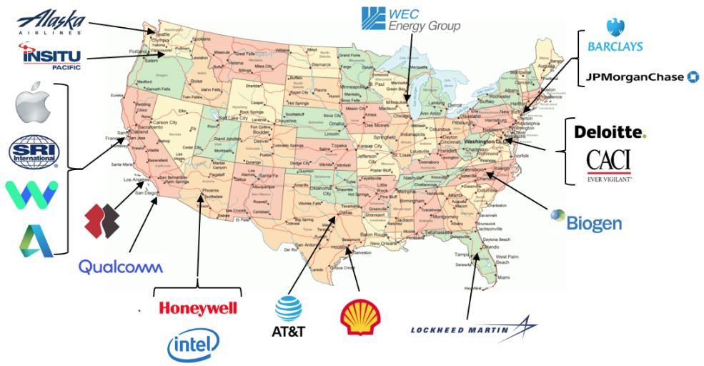
AY 19-20 Program Overview
2

Slide 3
The Why…
Established by SECDEF as a long-term investment
Transforming DoD forces and capabilities
Opportunity for DoD to gain access to executive level business practices inside highly successful corporations
Strategic Planning
Organizational Structures
Change Management
Human Resources
Information Technology
Supply Chain
Businesses outside DoD successful in:
Adapting to changing global environment
Exploiting information revolution
Structural reshaping/reorganizing
Developing innovative processes
Reforms can generate Defense Budget Savings
3

Slide 4
The How…
Participants from all Services & Defense Agencies
O-5/O-6 or GS-14/15
Flag/General Officer or Senior Executive Service potential
Senior Service College/Fellowship Board selected
Initial group education month
Current political/military issues; leading edge technologies
Meetings with senior DoD officials, Congressmen, press, alumni
Tailored Graduate Business school Executive Education
Eleven month at unique mix of Corporate Sponsors
Combination of operational duties and meetings with senior executives
Unexpected challenges, valuable insights
Acquisitions, mergers, restructuring
Group training for 1 - 2 days at each sponsor
Meetings w/ senior executives to learn strategies, challenges, best practices
Business area education
Site visits for business operations, manufacturing, etc.
Expanded training for each participant across multiple business sectors
4

Slide 5
The Results
Continued strong support from Corporate Sponsors
Variable mix of sponsors across wide business area range
Education³
DoD, Individual officers, Corporate Sponsors
Intra-group experience sharing; fresh perspectives for all parties
Military and civilian leaders who:
Understand more than the Profession of Arms
Understand business culture & varied corporate decision processes
Recognize organizational and operational opportunities
Understand skills required to implement change
Will implement and motivate innovative changes throughout their career
Briefings to Senior DoD civilian / military leaders
DEPSECDEF, VCJCS, Service Secretaries & Chiefs
Deputies for Programs, Budgets, Acquisitions, T&E, Personnel, IT, etc.
Group corporate experience observations and recommendations
5

Slide 6
AY19-20 Executive Take-aways
01
Talent Management
02
Resilient Supply Chain
03
SDEF Program Evolution
04
COVID-19 Response
6

Slide 7
Talent Management
Deliberate hiring process for the position needed in the organization
Private sector quicker and more communicative at hiring actions
During hiring focus on interviews to ensure best compatibility
Seek diverse experiences
Recruit
Focus on promoting diversity of thought
Collaborative workspaces with amenities making work easy and enjoyable
User-friendly IT, communications, and collaboration tools to increase productivity
Retain
Use of standardization and enforce processes that clearly link company performance metrics with individual objectives
Routine conversions (weekly or biweekly) support documented quarterly conversations
Leadership group review and discuss the “what” and “how” of an employee’s yearly performance review
Performance & Potential Assessment
Methodical succession planning
Widespread utilization of recording technologies to allow post-training web access to the information
Development
7

Slide 8
Resilient Supply Chain
Deliver or obtain item (product, capability, part, etc.) at time and place needed
Procure and deliver quality items at favorable prices
Adhere to responsible production processes
Aligned Goals
Effectiveness at least as important as efficiency
Multiple suppliers for high risk or critical items
Understand multiple layers of subcontractors
Data analytics support a forward-looking supply chain
Mandated business continuity plans for all suppliers, exercised periodically
Corporate
Methodology
DOD policy excessively bureaucratic and expensive with offices that have overlapping responsibility
Suppliers and DOD need transparent collaboration on risk, mitigation, and policy
Tax incentives to promote commercial and national security supply chain resiliency
Policy
Considerations
8
Notes:
Goals: Corporate and Government goals have a lot of alignment.
Both need/want product when needed either to buy or to sell
Both want favorable pricing from suppliers
Both want to be socially responsible (not using forced for bonded labor, or minerals not sustainable sources)
Method: What is being done to mitigate the risk?
- Supplier Risk Assessment
- usually a tiered system, initially based on suppliers’ financials, systems are getting more sophisticated
-Tiered system ranks tier one suppliers based on the suppliers’ risk (financials, historical performance, location, possible tier 2 supplier information if known), higher risk suppliers have mandatory additional requirements/oversite
-Key material or nodes generally warrant an alternate supplier if available (additional cost, but cost of no produce for customer is higher)
-Automated notification to corporation and suppliers, suppliers prompted to submit responses (service frequently provided by 3rd party: DHL Resiliency 360, IBM Sterling Supply Chain, Resilinc, Supply Risk Solutions; requires upload of suppliers to 3rd party)
-Business Continuity Plans are generally on file for all suppliers, however the completeness of the BCP can vary greatly
Alignment:
-Corporate concerns over DoD requirements being costly and duplicative, with minimal gain
-Need Government and Corporate alignment on the risks, and what is currently mitigating them
- Tax incentive could raise the resiliency of products for all consumers not just DoD and defray the costs

Slide 9
SDEF Program Evolution
Assign outgoing Fellow as SDEF Associate Program Director
Require Services to identify fellows NLT 31 JAN
Complete corporate sponsor pairing NLT 31 MAR
Evaluate Sponsor companies for quality of Fellow experience
Program Execution
Review, validate, and update pre-fellowship training requirements
Introduction to innovative DoD units: (e.g. Defense Innovation Board, Defense Innovation Unit, NavalX, USMC Center for Warfighting Analysis, AFWERX)
Attend DoD/Industry innovation events (e.g. Defense Innovation Network Summit, West 2020)
Assign each Fellow a service GOFO mentor
Fellowship
Preparation
Improve reutilization tour placement to capitalize on SDEF skills
Explore option to “bundle” follow-on assignments
Develop list of critical OSD/Service innovation billets
Develop SDEF outplacement career progression path
Survey former Fellows to gauge program efficacy/improvements
Reutilization
9

Slide 10
COVID-19 Response
COVID-19 instantly redefined how global companies posture themselves to maintain long term success; provided Fellows the opportunity to observe corporate best practices.
Implemented company directives and policies to protect workforce ahead of federal guidance
Modified production lines and services to meet government and market demands
Pivoted organization to current need while balancing normal priorities
Transitioned to information age mindset (Cloud based solutions, flexible work hours)
Updated human resource Work From Home (WFH) policies to guide expectations
Agility
Prior issuance of individual laptops eased moved to WFH environment
Supported WFH with home delivery of workstation bundle (monitor, keyboard, & mouse) to facilitate convenience and productivity
Early & timely adoption of cloud based workforce integration (cloud environment, video platforms, bandwidth)
Tech allowance (personal vs DoD infrastructure) or Tech Tax Credit to offset individual cost
Accelerate FEDRAMP approval process to allow civilian software on DoD infrastructure
Technology
Executive decision making supported both short and long term implications (short-term - revenue; long-term - respond to industry changes)
Budget consistency allows proactivity vs reactivity during difficult times
Maintain a strategic mindset when making short-term decision
Sustainability
Focus on keeping connection with employees throughout the crisis (important vs urgent)
Supported with mindfulness products and engaging insurance companies to expand available mental health options
Resiliency
DoD Takeaways: Embrace new methodologies available to meet mission needs, even when it is completely different than anything previously done. Leverage civil best practices when meeting the defense needs of our nation.
10

Slide 11
Questions?
11

