Slide 1
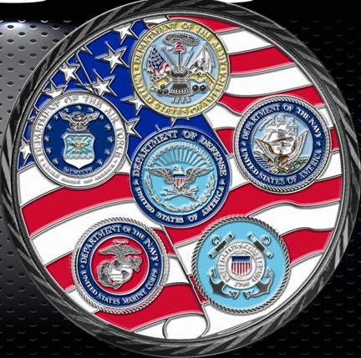
Secretary of Defense Executive Fellows
Academic Year 2018-2019
Entire Brief is UNCLASSIFIED

Slide 2
The Why…
Established by SECDEF Perry as a long-term investment in transforming DoD forces and capabilities
Opportunity for DoD to gain access to executive level business practices inside highly successful corporations
Strategic Planning - Organizational Structures
Change Management - Human Resources
Information Technology - Supply Chain
Businesses outside DoD successful in:
Adapting to changing global environment
Exploiting information revolution
Structural reshaping/reorganizing
Developing innovative processes
Reforms for better performance, accountability, affordability

Slide 3
The How…
Twenty Fellows from all Services, including Coast Guard
O-5/6 or GS-14/15
Flag/General Officer or Senior Executive Service potential
Senior Service College credit
Initial group education month
Current political/military issues; leading edge technologies
Meetings with senior DoD officials, business executives, press, alumni
Tailored Graduate Business school Executive Education
Eleven months at unique mix of Corporate Sponsors
Combination of operational duties and meetings with senior executives
Unexpected challenges, valuable insights
Acquisitions, mergers, restructuring
Group training for 1 – 2 days at each sponsor across multiple industries
Meetings w/ senior executives to learn strategies, struggles, best practices
Business area education
Site visits for business operations, manufacturing, etc.

Slide 4
Corporate Sponsors
Prior Years
3M, ABB Group, Accenture, Agilent Technologies, Alaska Airlines, Amazon, American Management Systems, Amgen, Apple, Arizona Public Services, AT&T, Autodesk, Biogen, BlackRock, Bloomberg, Boeing, Booz Allen, CACI, Caterpillar, Cisco, Citigroup, CNN, CVS Health, Dell, Deloitte, Deutsche Bank, DirecTV, DuPont, Dynamic Aviation, EADS, EMC, Enron, ExxonMobil, FedEx, General Dynamics, Georgia Power, Google, Hewlett-Packard, Honeywell, Human Genome Sciences, IBM, Insitu, iRobot, Intel, JPMorgan Chase, Johnson & Johnson, Lockheed Martin, Loral, McAfee, McKinsey, McDonnell Douglas, Merck, Microsoft, Mobil, Morgan Stanley, Netscape, NCR, Norfolk Southern, Northrop Grumman, Oracle, Pfizer, Pratt & Whitney, PricewaterhouseCoopers, Raytheon, Salesforce.com, SAP, SRI/Sarnoff Labs, Sears, Shell Oil, Sikorsky, SpaceX, SRA International, Sun Microsystems, Symbol Technologies, Textron, Union Pacific, United Technologies, Vertex Aerospace
AY 2018-2019
3M, Accenture, Amazon, Autodesk, Boeing, Cisco, Deutsche Bank, Google, Johnson & Johnson, McAfee, McKinsey, Merck, Microsoft, Pratt & Whitney, Raytheon, SAP, SpaceX, Textron, Union Pacific, VMware

Slide 5
The Results…
Continued strong support from Corporate Sponsors
More Sponsors than Fellows available
Education³
DoD, Individual officers, Corporate Sponsors
Intra-group experience sharing; fresh perspectives for all parties involved
A cadre of military and (going forward) civilian leaders who:
Understand more than the Profession of Arms
Understand business culture & varied corporate decision making processes
Recognize organizational and operational opportunities
Understand skills required to implement change
Will implement and motivate innovative changes throughout their career
Individual Briefings to Senior DoD civilian/military leaders
DEPSECDEF, VCJCS, Service Secretaries/Chiefs
Deputies for Programs, Budgets, Acquisitions, T&E, Personnel, IT, etc.
Twenty-seven briefings to 42 senior leaders in June 2018
Group corporate experience observations and recommendations for DoD

Slide 6
Lessons Learned
Acquisition : Customer Urgency / Prototype / Iterate
Leadership and Culture: Value & Empower People
Leadership: Common & Compelling Vision
Management: Efficiency / Change Management
We Intend to Implement These Lessons Locally,
Vice Recommending / Waiting for Top Down Change

Slide 7
ACQUISITION
Customer Urgency / Prototype / Iterate

Slide 8
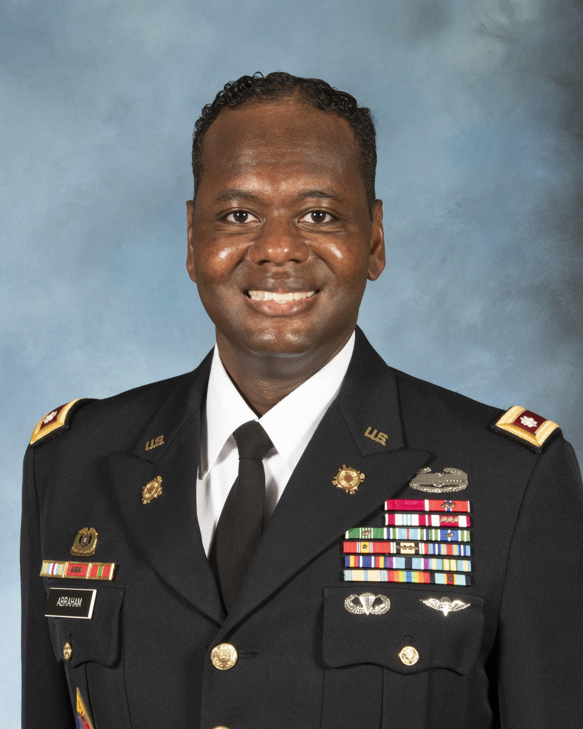
LTC Courtney Abraham, USA
Corporate Sponsor: SAP
Next Assignment: Joint Personal Property Shipping Office Ft. Belvoir, VA
Lessons Learned: Understand Customer Experience
matters. Bringing in key values to the organization that
customers will also experience, trust, and believe in.
Reinvigorating customer engagements, QA/QC...bringing innovative solutions to a 2019 problem. Understanding that new efficiencies can reduce the customer experience and business engagement.
As the CDR, JPPSO, every customer deserves a high-quality, high-touch experience built on a foundation of empathy, business insight, and differentiated value.

Slide 9
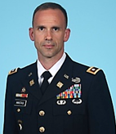
LTC Matt Anastasi, USA
Corporate Sponsor: Raytheon Space & Airborne Systems
Next Assignment: Support Operations Officer
21st Theater Sustainment Command, GE
Lesson Learned: Customer focus is critical
Raytheon is highly customer focused with the goal of anticipating requirements and delivering the best possible solution. Significant effort to change the culture of the company to support the “go fast” acquisition environment.
I plan to incorporate this lesson in my next assignment through a culture of acceptable risk tolerance to deliver support to customer units (80% solution now is better than the 100% solution late).

Slide 10
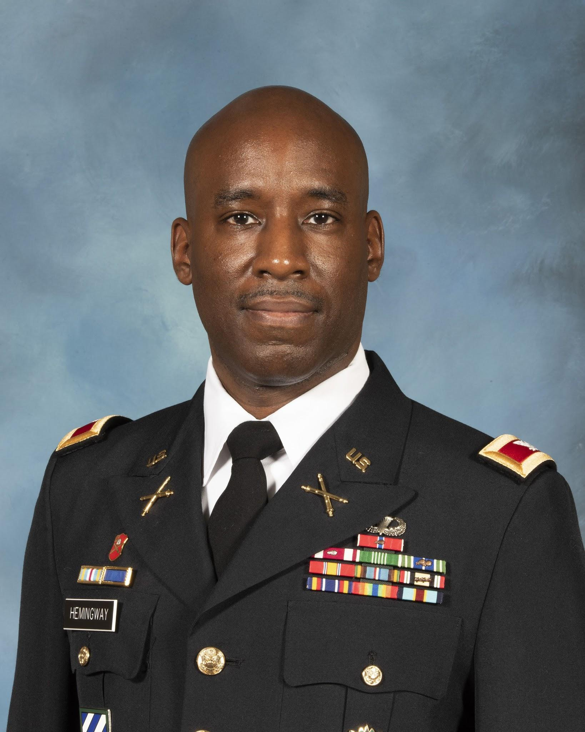
COL Corey Hemingway, USA
Corporate Sponsor: Google
Next Assignment: Project Manager
Cyberspace, Testing, Special Operations
Lessons Learned: Be audaciously bold and prototype driven
Google use three factors as foundations of product development. Empathize with the user, think 10x, build Prototypes. Google is willing to go the extra mile to understand and build products that people want, challenge the team to go beyond expectations and build prototypes in a collaborative effort. Be willing to fail and celebrate learning from failure.
I plan to use this experience to improve the culture of my organization. Emphasizing the same principles will improve speed of delivery but willing to take prudent risk. Providing my team the tools to improve collaboration with the user is priority #1. Establishing metrics and benchmarks that challenge the team go beyond expectation and rewarding failure/learning with every opportunity. Challenge industry partners to prototype quickly so users can test and collect data that is meaningful.

Slide 11
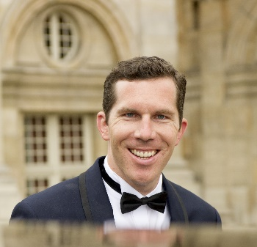
Jeremy Mucha, USN CIV
Corporate Sponsor: SpaceX
Next Assignment: Technical Director
National Communications Systems
National Reconnaissance Office (NRO)
Lesson Learned: Reduce Requirements & Iterate
SpaceX demonstrated this lesson by trading away some initial Starlink capabilities in order to accelerate schedule. By also taking calculated risks, SpaceX was able to get a minimum viable product tested and monetized before any of its competitors.
I plan to incorporate this lesson in the same fashion during my next assignment. Emphasize urgency to get viable capability to users as quickly as possible. Seek deferments or waivers for requirements that threaten this strategy. Leverage commercial products to the maximum extent possible.

Slide 12
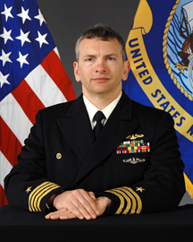
CAPT Paul Pampuro, USN
Corporate Sponsor: Cisco Systems
Next Assignment: APM Submarine Comms Program Office
Lesson Learned: Everything I need to know I learned in
Bootcamp
The Golden rule is as relevant in Corporate America as it is in the military
If you are not failing, you are not trying hard enough (Accepting Failure)
Small course changes deliver more value than large rudder swings (Agile Development)
Life is tough or you are not playing hard enough, everything gets better after X

Slide 13
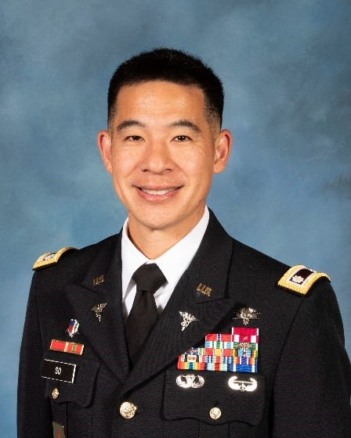
COL Nelson So, USA
Corporate Sponsor: Merck and Co.
Next Assignment: Military Health System Transition Lead,
Regional Health Command - Pacific
Lessons Learned: Agility, Digital Transformation, Talent Management
The transformation of Merck in the last decade has been astounding. In 2009, Merck, which prides itself as a research-driven company, had a barren pipeline. However, since then Merck has revitalized its research pipeline and transformed the company into a global oncology and vaccines leader. Despite reasserting itself as a leader in the pharmaceutical industry, global pressures on access and pricing are forcing the company to reinvent itself again.
Agility: Merck is striving to become more agile in product development and marketing
Digital Transformation: Merck captures lots of research, manufacturing, and marketing data but is lagging in how it leverages this data to gain insights, iterate quicker, and to be more responsive to customers (governments, payers, providers, and patients).
Talent Management: The competition for talent across in the pharmaceutical industry is extremely fierce. Merck is trying to improve its processes for recruiting, retention, talent management, and leader development.
I plan to incorporate these lessons learned in my next position as I help to lead Army MHS transformation efforts in the Pacific region.

Slide 14
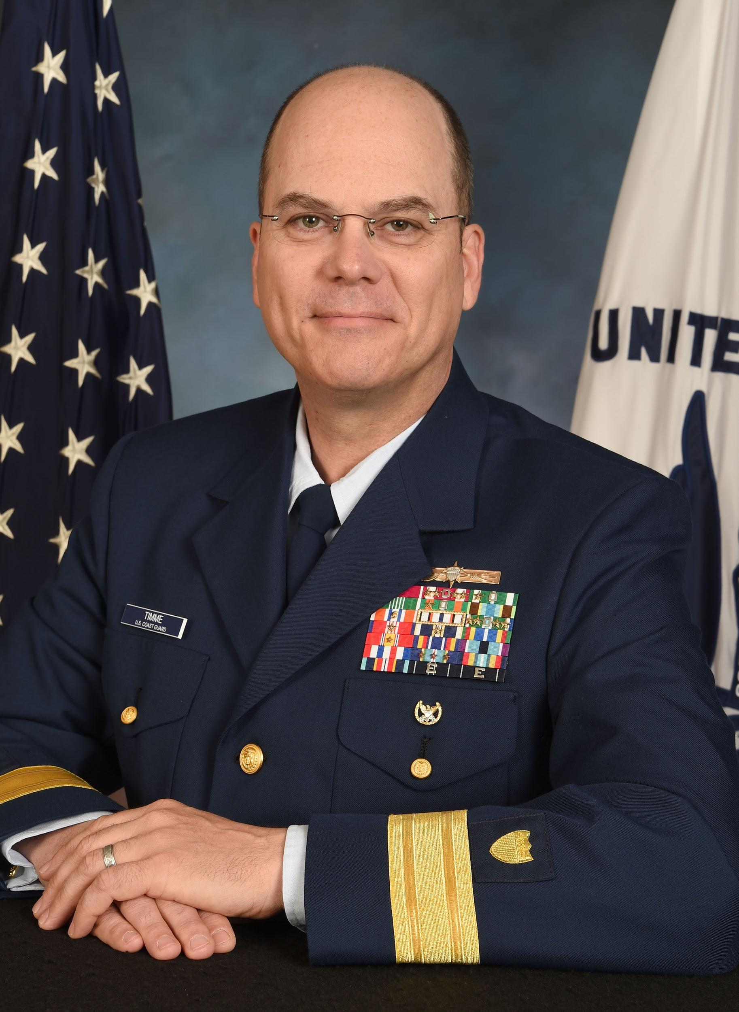
RDML Richard Timme, USCG
Corporate Sponsor: McKinsey & Company
Next Assignment: Assistant Commandant for Prevention Policy (CG-5P)
Lessons Learned: Rapid iteration drives decision making; treating knowledge as a strategic asset drives top down behaviors.
McKinsey standard approach to problem solving includes the expectation of a hypothesis to solve to the clients problem by the end of the first day of engagement. Rapid, constant iteration through a collaborative process drives successful solutions that are transparent to all.
McKinsey doesn’t make widgets; their product is their expertise and knowledge. That knowledge is made available firm-wide. The most junior associate is EXPECTED to reach out to the most senior Partner globally, if that is where the knowledge resides. The Partner is EXPECTED to respond without further justification beyond name of the partner running the associate team.
I will model behaviors that reflects the urgency of rapid iteration with my senior staff; and model a behavior of knowledge-sharing with my mid-grade and junior staff.

Slide 15
LEADERSHIP & CULTURE
Value & Empower People

Slide 16
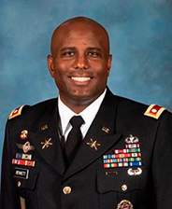
LTC BJ Bennett, USA
Corporate Sponsor: McAfee LLC
Next Assignment: Assistant COS/G-3
32nd Air & Missile Defense Command
Lessons Learned: Culture, Recruiting, Cross Functional Business Units, Balancing Risk
The company continues to refining its systems and processes in order to facilitate profit
Fosters a culture of cross functional thinking and collaboration through business partners
Executes risk management boards
In my next assignment
People first
Facilitate cross functional teams in garrison
Make risk management a team effort
Seek ways to improve systems and processes

Slide 17
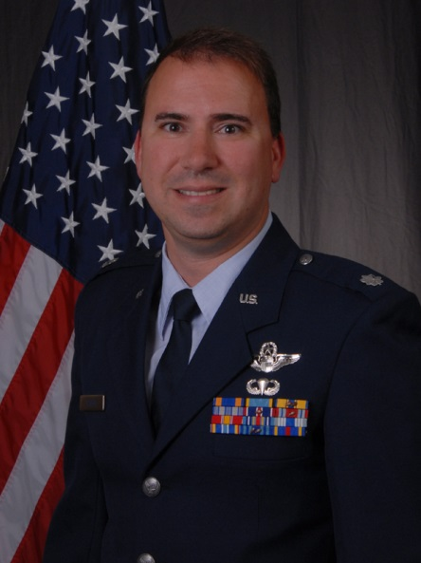
Col Tom Bladen, MA ANG
Corporate Sponsor: Textron Systems
Next Assignment: Vice Commander, 104th Fighter Wing
Lesson Learned: People-oriented value systems with disciplined alignment yields phenomenal results
Several companies tangibly demonstrated this concept by prioritizing their people over their revenue. “Philanthropic paid time off,” campus-like environments, community support work centers, telework policies, evaluation systems, delegation of decisions, etc. create costs but also create net income by attracting talent, retaining talent, and allowing creative solutions to unfold.
I plan to incorporate this lesson at my wing by modifying our strategic planning process, propagating a more egalitarian mindset (where it makes sense), seeking ways to be more empathetic and trusting in our policies whenever possible.

Slide 18
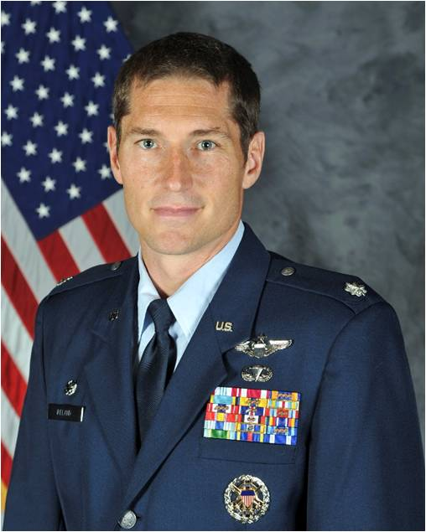
Lt Col Dustin Ireland, USAF
Corporate Sponsor: Pratt & Whitney
Next Assignment: AF Life Cycle Management Center
F-22 Program Office
Lessons Learned: The best leaders remove barriers that restrain employees. Whether these barriers are perceived or real, the best leaders do not hesitate to do the little things that make the big things possible.
P&W began a cultural transformation in 2016. The P&W culture focuses on empowering employees by providing a military style - “Commander’s Intent” which P&W describes as their “Leader’s Intent.” This concept is flourishing on the commercial side of P&W yet is slow to take route on the military side of the business. The military side of P&W is heavy on prior military members. I perceive the prior military experience of these employees forces a process driven, “barrier focused” mindset.
I plan to use my experience at P&W to strengthen my leadership style. I will seek to provide my next team with challenging goals and then step back, allowing leaders space and resources to execute. When barriers arise I will quickly remove those barriers or help mentor the team to adjust their perspectives to dissolve perceived barriers. Ultimately, my goal is to strip away perceived detractors and barriers to allow empowerment to flourish.

Slide 19
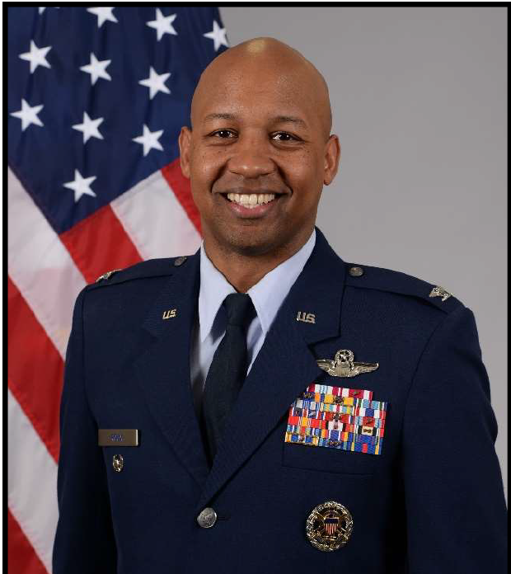
Col Jaron Roux, USAF
Corporate Sponsor: Accenture Federal Services
Next Assignment: Vice Commander
380th Air Expeditionary Wing
Al Dhafra AB, UAE
Lesson Learned: Know your value & articulate people's
value to your organization back to them.
Accenture has found a way to separate promotion from compensation. They have adopted a “performance achievement” model vs a “performance management” model.
How do we spend millions of dollars training people, who can do their jobs to the level we train them to, but yet tell them they are below average?
As the 380th AEW Vice Commander, I intend to focus my efforts on ensuring every person in the 380th knows how valuable they are to the combat mission in our AOR.

Slide 20
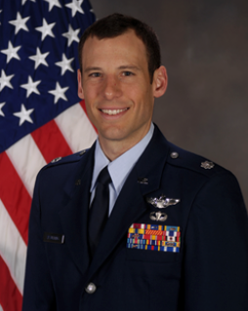
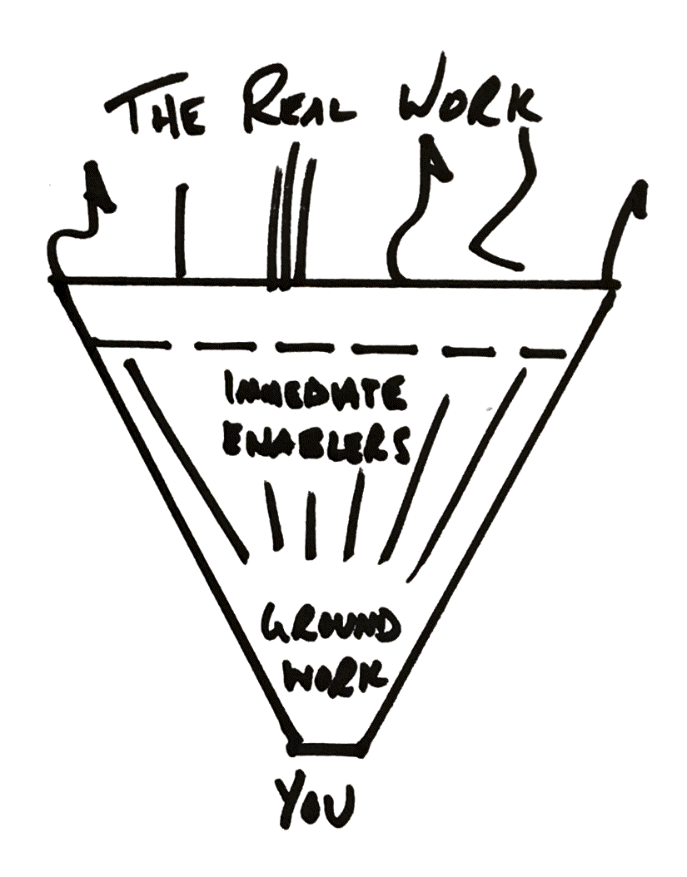
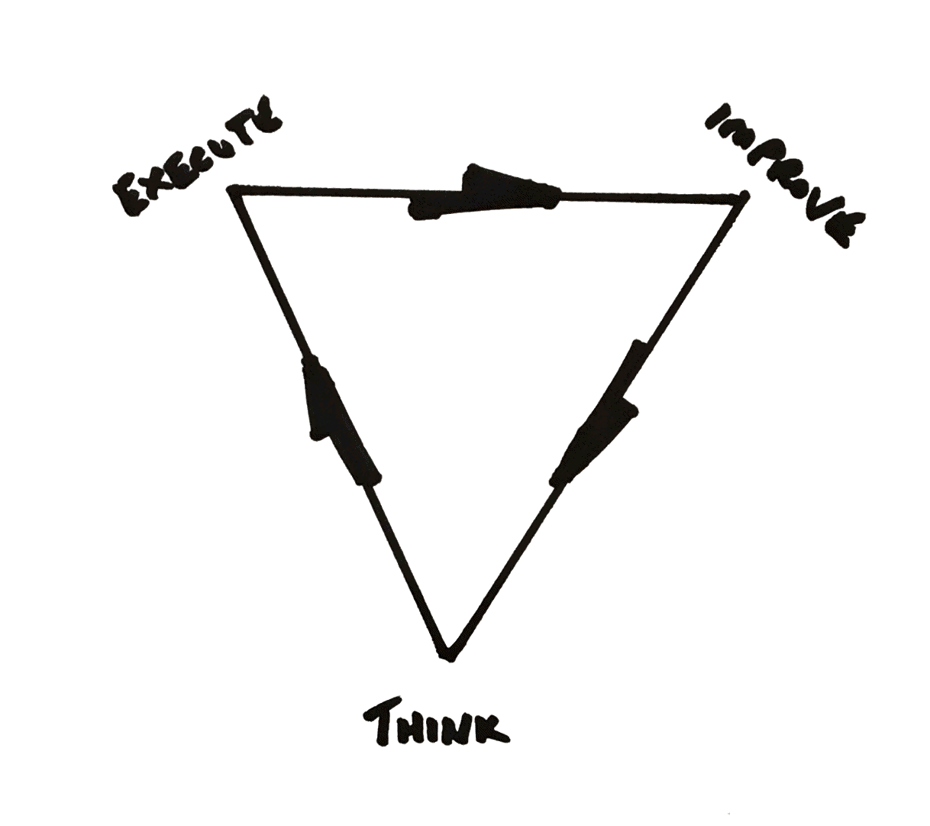
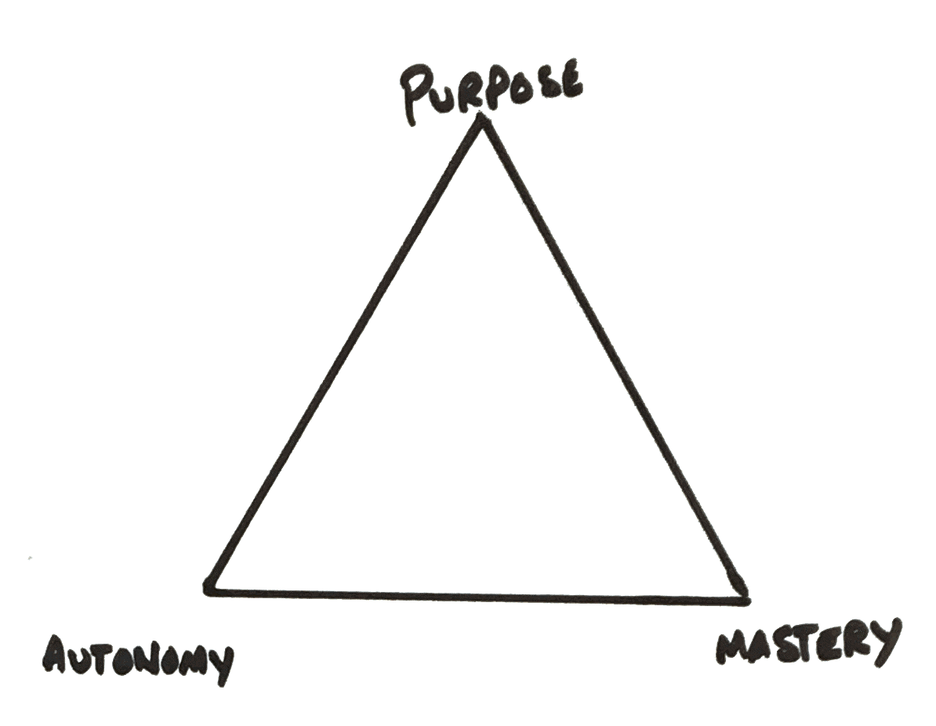
Col Tim Spaulding, USAF
Corporate Sponsor: Autodesk
Next Assignment: Commander, 412th Operations Group Edwards AFB
Lessons Learned: Our strengths and weaknesses as an organization.

Slide 21
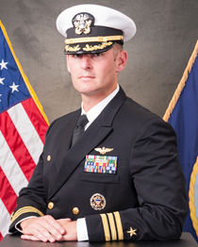
CDR Benjamin Van Buskirk, USN
Corporate Sponsor: VMware, Inc.
Next Assignment: TBD (N7 or USSOCOM Chief Data Officer)
Lessons Learned: Our people are our customers/end
users. Adjust technology to the end user vice the end
user adjusting to the technology. Empathy critical. Trust
& empower through bold and fearless leadership. Will need to break glass and challenge the status quo at the core to be effective.

Slide 22
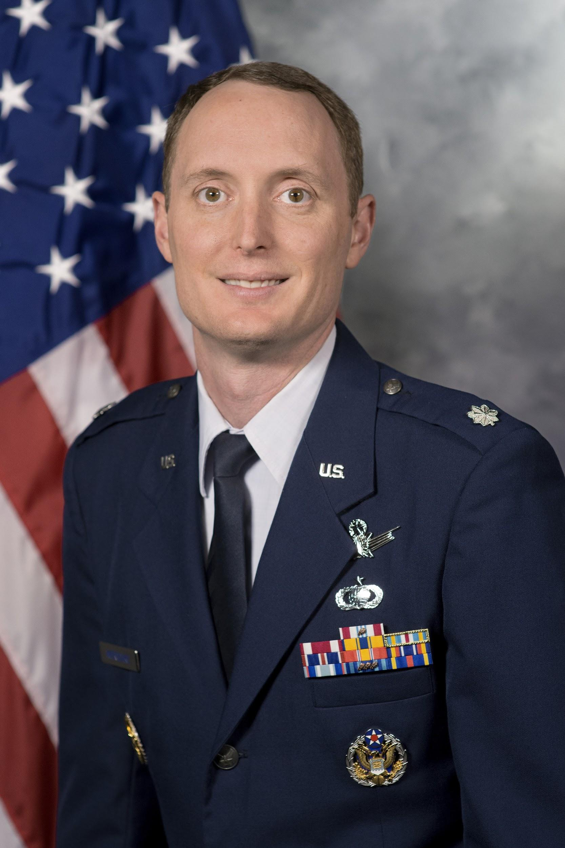
LtCol Kevin Wierschke, USAF
Corporate Sponsor: Amazon Web Services
Next Assignment: J82, Joint Warfare Analysis Center
Lessons Learned: Customer Obsession, Ownership, and Data Driven Decision Making
Amazon obsesses over their customers. They study their problems and work backward to develop solutions. They challenge assertions by diving deep into the data. Problems are owned by small teams that are empowered to do what is necessary to deliver these solutions. Systems are “loosely” coupled to enable this empowerment.
I plan to use these experiences to improve my new organization and my leadership style. Priority 1: ensuring work is divided to create an “ownable” customer problem. Next, I plan to set the stage for true empowerment by working to align incentives across the functionals, eliminating gatekeepers where ever possible, and enhancing data collection and analysis capabilities to ensure we have the data to drive our decisions.

Slide 23
LEADERSHIP
Common & Compelling Vision

Slide 24
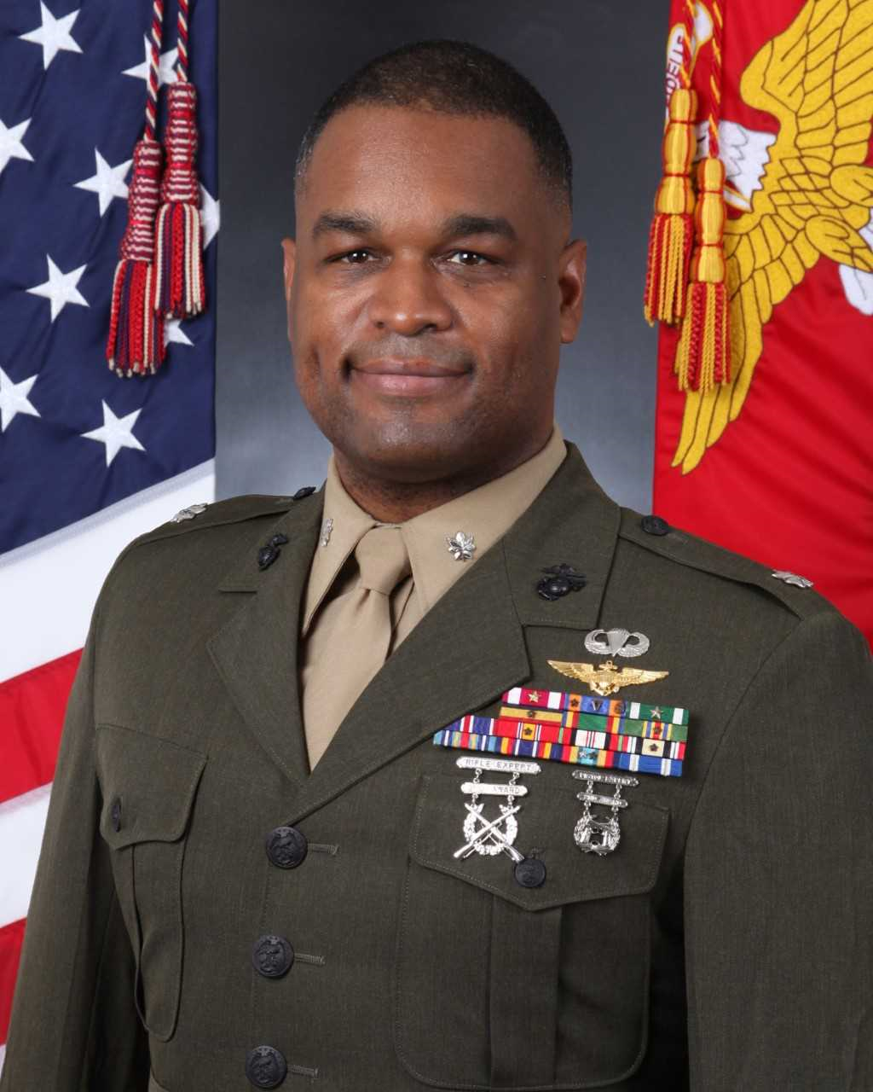
LtCol Llonie Cobb, USMC
Corporate Sponsor: Johnson & Johnson
Next Assignment: 1st Marine Air Wing
III Marine Expeditionary Force
Lesson Learned: Ensure the entire workforce has a firm grasp on the institutional values and priorities
The J&J Credo is the common touchpoint for all employees. It is regularly referenced, it drives all decisions, and it is not obscured by other "principles" or "traits."
As the 1st MAW IG, I will assist with ensuring that high optempo and tasking do not obscure Service values and priorities at 1st MAW MSCs. I will also be sensitive lead indicators of deviation.

Slide 25
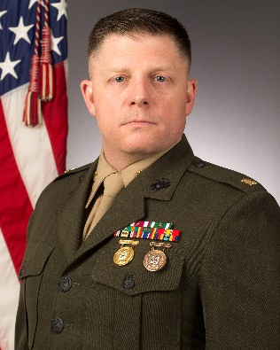
LtCol Andrew Konicki, USMC
Corporate Sponsor: Microsoft Corporation
Next Assignment: PM, Infantry Combat Equipment, Marine Corps Systems Command
Lesson Learned: Unity of Purpose
Microsoft embodies their mission “to empower every person and every organization to achieve more” through their culture and sense of focus.
As the Program Manager for Infantry Combat Equipment, I intend to orient my team on the mission of equipping the warfighter. Every action we take is movement to fielding and/or improving capability to either protect our troops or cause harm to the enemy.

Slide 26
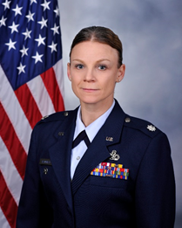
Lt Col Katrine Waterman, USAFR
Corporate Sponsor: Boeing
Next Assignment: Commander, 911th Maintenance Group
Pittsburgh ARS, PA
Lesson Learned: An enterprise strategy that is compelling, clear and easy for EVERY employee to see how they fit into is paramount.

Slide 27
MANAGEMENT
Efficiency / Change Management

Slide 28
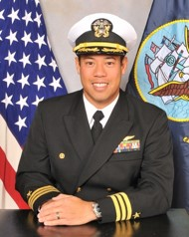
CDR Dan delaCruz, USN
Corporate Sponsor: 3M
Next Assignment: J33, EUCOM Staff
Lesson Learned: Change Management / Lean Six Sigma (LSS)
3M uses LSS as one of three avenues to develop high potential individuals. LSS not only emphasizes finding efficiencies within a process, but ultimately teaches change management to future leaders.
I plan to incorporate these management / leadership techniques during my next assignment. Through LSS I have found that creating a cross-functional team that collaborates on a goal or project will ultimately facilitate adoption. Additionally, LSS has given me a process to more effectively prioritize levers I can use to create change.

Slide 29
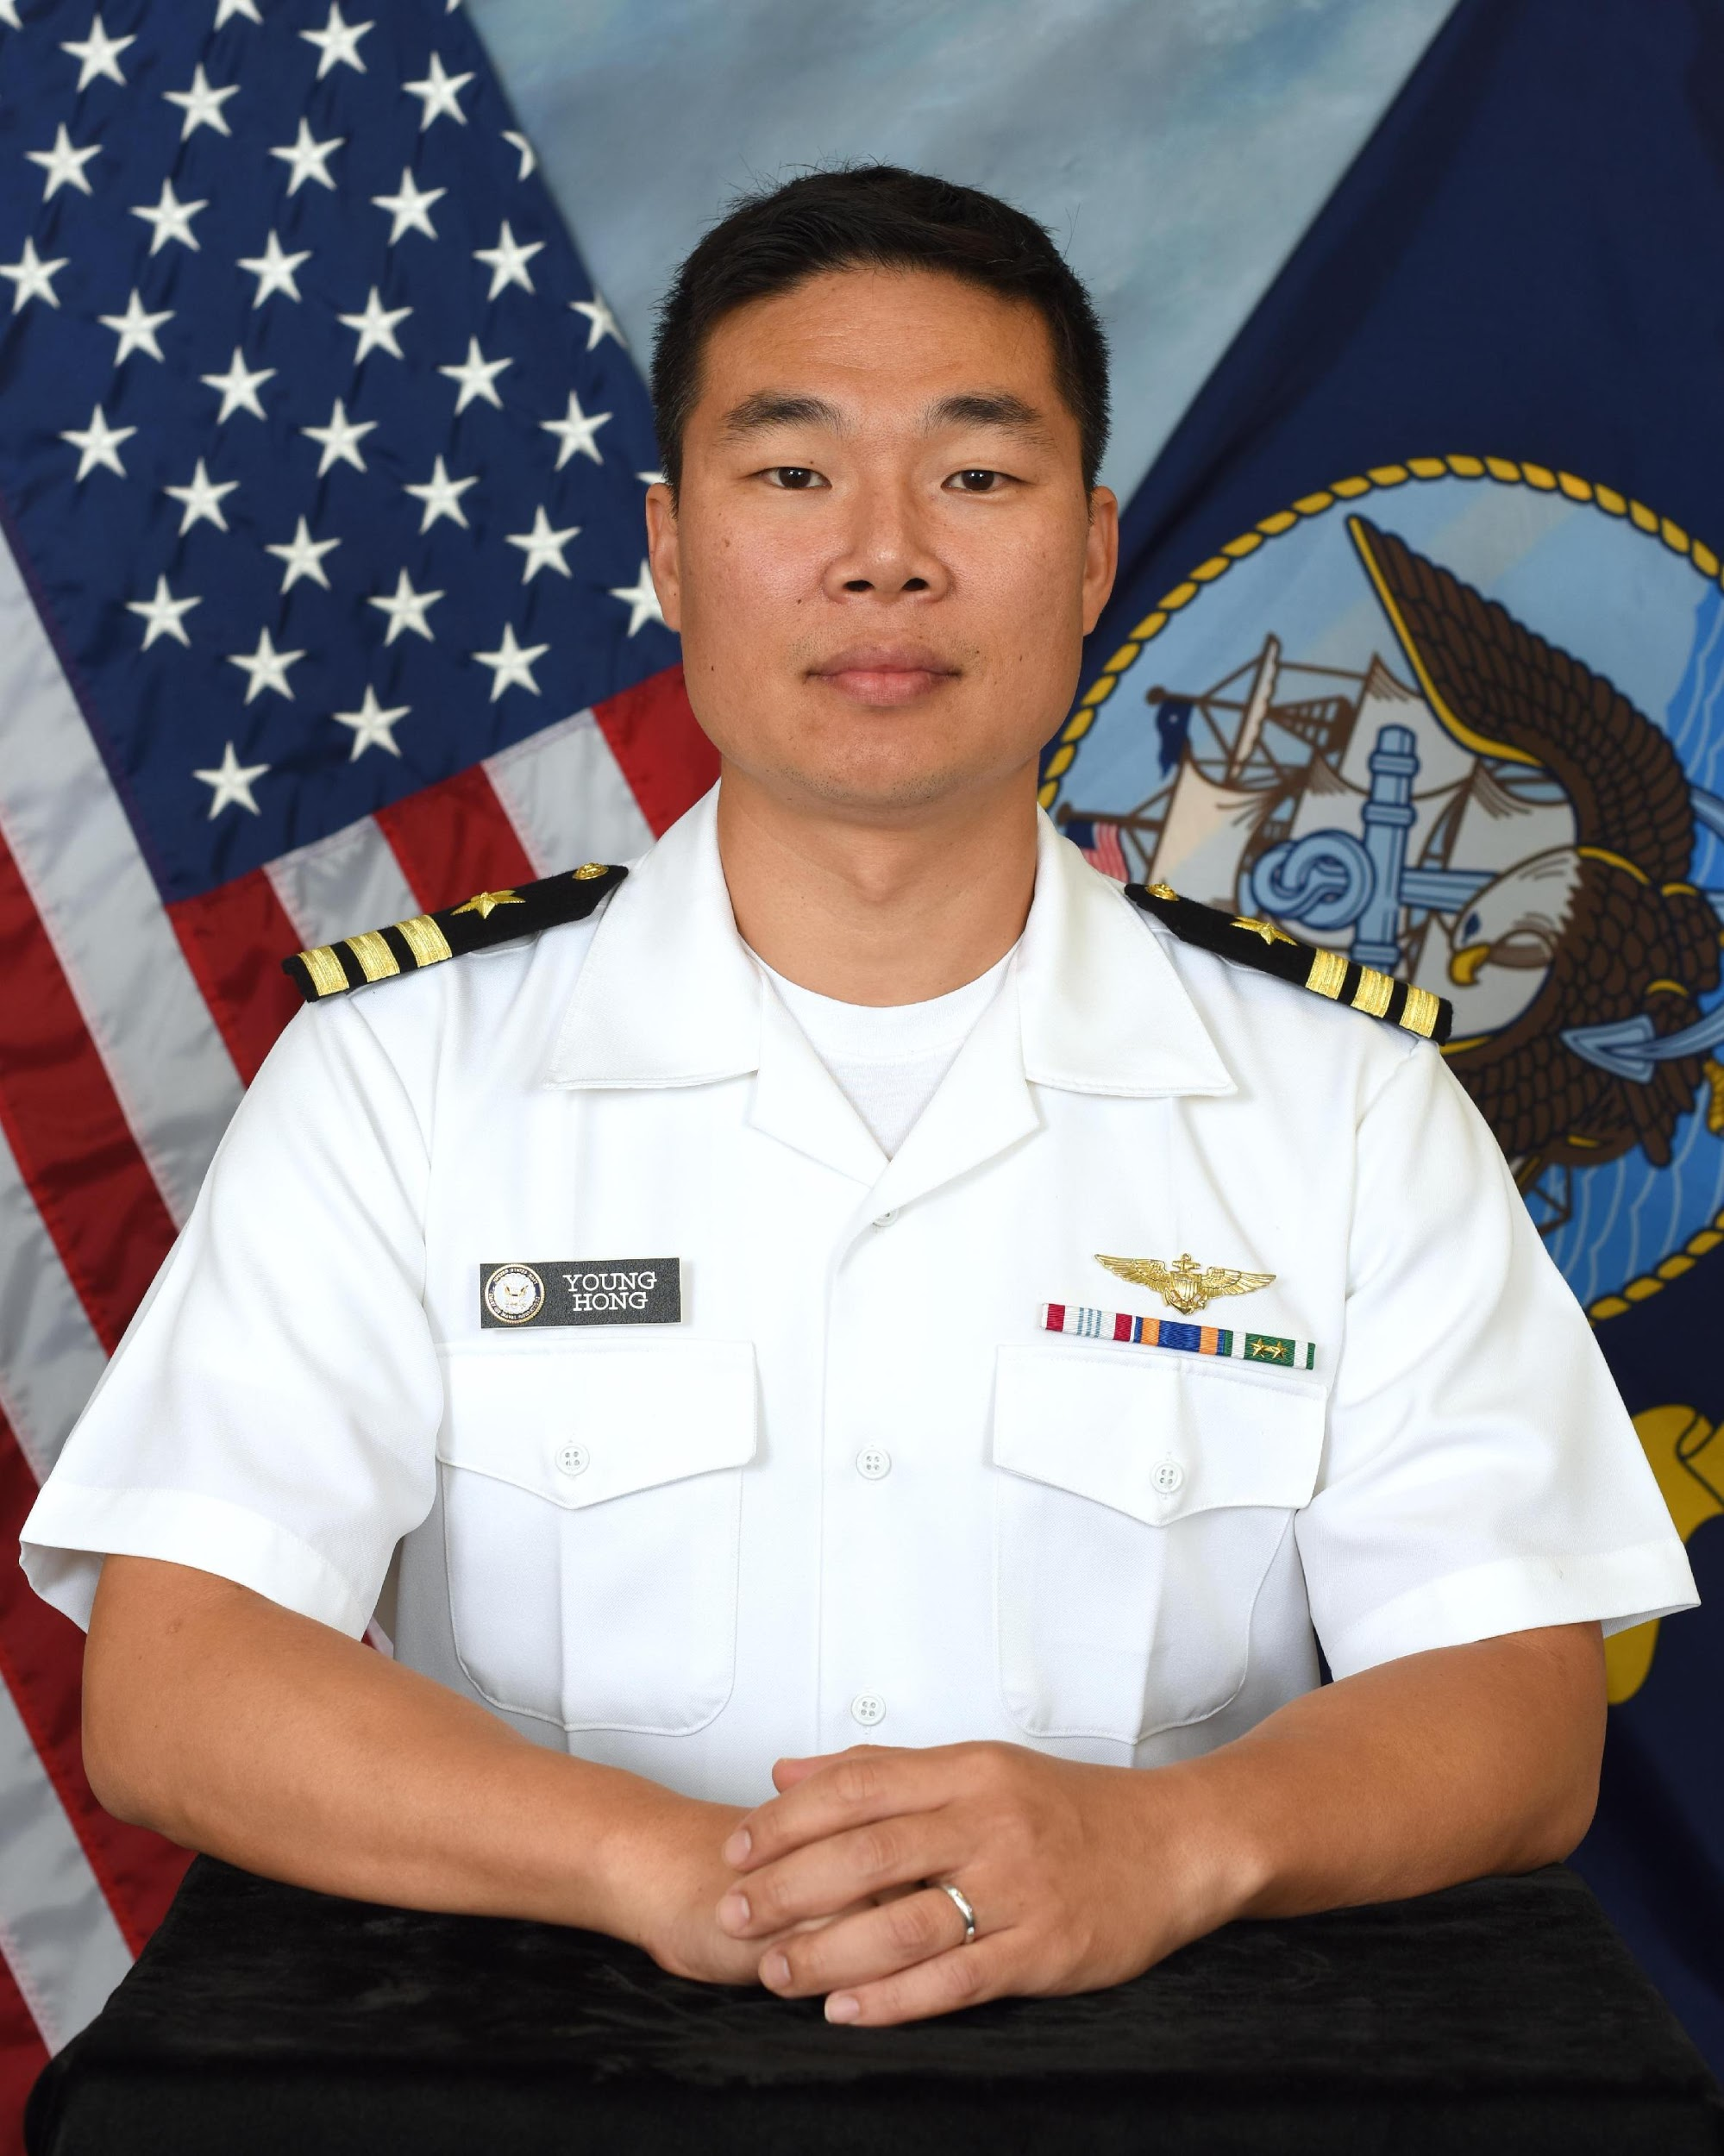
CDR Young Hong, USN
Corporate Assignment: Deutsche Bank, NY
Next Assignment: DON Chief Management Office
Lessons Learned: Embrace Audits, use it to cultivate change
At Deutsche Bank, audits and review of businesses occur frequently by comparing internal, third party audits and regulatory standards. Strategic decisions are made across the businesses for the bank, not for individual businesses. Overall goal is to strengthen the bank, the finance industry.
Remove “cheapest bidder” mentality in DoD.
Market our headquarters as a desirable place to work.
Identify and remove excess to strengthen “our industry.”

Slide 30
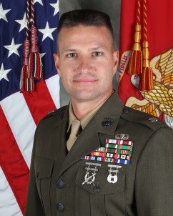
LtCol Jamey Stover, USMC
Corporate Sponsor: Union Pacific Railroad
Next Assignment: 1st Marine Logistics Group
(Camp Pendleton, CA)
Lesson Learned: Asset Utilization / Efficiency
Union Pacific (UP) implemented precision scheduled railroading principles with a new corporate strategy (UP 2020). This led to more mixed (manifest) trains than unit (single customer) trains with a focus on moving individual cars. UP drastically reduced locomotives, rail cars, employees, and infrastructure in an effort to “sweat the assets.” This innovative strategy made most customers fit their movements into what is best for UP’s rail operations network.
In my previous assignment, my battalion deployed on the USS AMERICA Amphibious Readiness Group (ARG)/15th Marine Expeditionary Unit (15th MEU). Our three ship ARG/MEU was the first deployment of the USS AMERICA and the first to experience a two well-deck ARG/MEU ship configuration. In this experience, we left approximately 46% of our equipment behind. During my fellowship at UP, I witnessed some of the same cultural challenges while UP changed operating principles, procedures, and mindsets. Now, I have two unique viewpoints that will seek continuous improvement and efficiency with my future teams and ask: 1) how can we do more with less 2) with pre-positioning, do we need to retain a full equipment set 3) how can we eliminate low efficiency and low value work 4) what value does this work provide to our mission
Lastly, ensure force deployment lift requirements are submitted on time and with as much accuracy as possible.

Slide 31
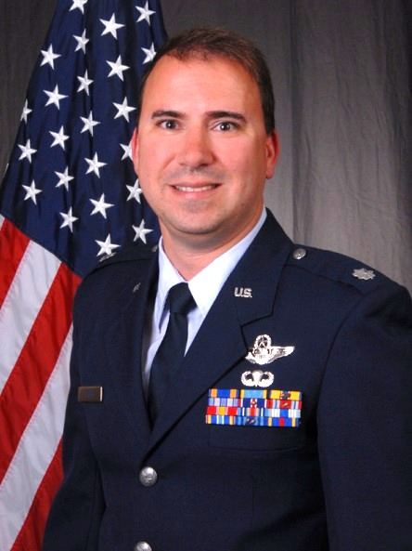
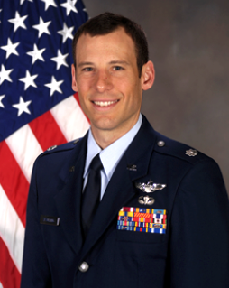
Facebook http://prhome.defense.gov/readiness/educationtraining/sdef.aspx
Tom Bladen
F-15 Pilot Weapons Officer
104th Fighter Wing Vice Commander
Dustin Ireland
A-10 Pilot Weapons Officer
Acquisition (F-22 SPO)
Jaron Roux
C-17 Pilot Weapons Officer
380 AEW Vice Commander
Tim Spaulding
F-15 Test Pilot
Ops Group Command
Katrine Waterman
Maintenance
Commander, 911th Maintenance Group
Kevin Wierschke
Space Acquisitions Officer
Joint Warfare Analysis Center

Slide 32
Facebook http://prhome.defense.gov/readiness/educationtraining/sdef.aspx
Courtney Abraham
Logistics
JPPSO, Mid Atlantic
Matt Anastasi
Logistics
SPO, 21st Theater Sustainment Command
BJ Bennett
Air Defense
ACoS / G-3, 32nd AAMDC
Corey Hemingway
Acquisition
PM Cybert Test, Special Ops Training Systems
Nelson So
Medical Service Corps
MHS Transition Lead,
Regional Health Command - Pacific

Slide 33
Facebook http://prhome.defense.gov/readiness/educationtraining/sdef.aspx
Ben Van Buskirk
Aviator, H-60F/H
TBD (N7 or USSOCOM Chief Data Officer)
Dan delaCruz
F/A-18F WSO
EUCOM Staff: J33
Young Hong
Aviator, H-60B/R
Navy Chief Management Office
Jeremy Mucha
Systems Engineering
Technical Director
National Communications Systems
National Reconnaissance Office (NRO)
Paul Pampuro
Submariner
APM Submarine Comms Program Office

Slide 34
Facebook http://prhome.defense.gov/readiness/educationtraining/sdef.aspx
Richard Timme
Marine Safety and Security Operations
Assistant Commandant for Prevention Policy (CG-5P)
Llonie “Shakes” Cobb
EA-6B Pilot / Strategist
1st MAW, III MEF
Andy Konicki
Ground Acquisition Professional
PM Infantry Combat Equipment, Marine Corps Systems Command
Jamey Stover
Logistics
1st Marine Logistics Group

