Slide 1
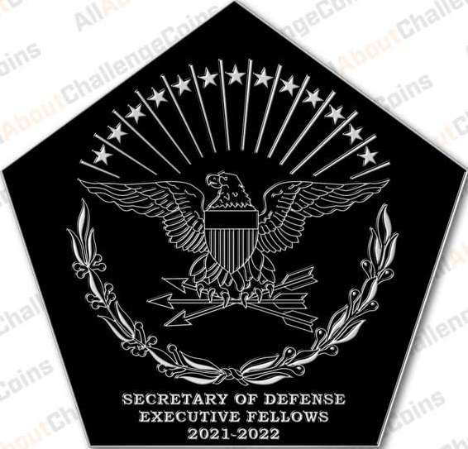
End-of-Year Briefing
Academic Year 2021-2022
Secretary of Defense Executive Fellows

Slide 2
AY 21-22 Key Takeaways
INNOVATION
PARTNERSHIP
TALENT MANAGEMENT
CULTURE
SDEF PROGRAM

Slide 3
Innovation
OBSERVATIONS
Industry is inherently more innovative than DoD – greater R&D funding & incentives
Innovation is not necessarily faster in the private sector
Innovation is a quantified, expected competitive imperative in corporate America
Successful innovation is a result of close practitioner-developer partnership
Clear, audacious objectives guide action, remove barriers, facilitating success
Not all fails are failures – expect to fail, plan to learn
RECOMMENDATIONS
Close the gap – engage broadly, increase contact surface
Partner openly – involve industry in “problem” definition, RDT&E, & exercises
Reduce barriers – facilitate tactical-level dialogue, iterate pursuits, ready adoption
Discourage “NO” – release grasp on TTPs, require proof of “NO”
Demand open architecture – reduce pursuit size, increase opportunities
Incentivize “troublemakers” & challenge norms
Retain & reward innovators that challenge status quo
Capitalize on innovation hubs to increase agile testing
Notes:
Obs
* Hart (competition)
*
* Sprague (metrics), Allen (digital trans)
*
*
* Kahle (empower), Rhinehart (learner mindset)
Rec
* A Black (pigeon hole), Taylor (understand, awareness)
* A Black (Partner), Newman (involvement)
* Charles (variety), Xu (tactical units), Rhinehart (deep R&D)
* Colvin (TTP), D Black (TTP), Xu (federated computation)
* Durham (MOSA)
* Stepp (innovative capacity), Xu (net-promoter)

Slide 4
Partnership
OBSERVATIONS
Industry feels they are “chasing requirements” – they desire dialogue
Overclassification/SAP stovepipes limits dialogue & participants
Industries are converging - tech dispersion is driving cross-domain consumer expectations & reshaping competitive landscape
Bureaucracy discourages/impedes partnerships
Industry pessimistic on working with DoD
RECOMMENDATIONS
Remove barriers – reassess and remove policies/procedures that make it difficult for Industry to work with us; engage with greater utilization of Industry Days
Target multi-domain buys – engage beyond single-domain/service requirements
Commit early – allow industry to engage supply chain to manage inflation
Engage “team” – multi-company brainstorming, invite to demos/exercises, & capture feedback/observations
Leverage corporate America to assist Nat’l Security goals
Don’t let ego detract from partnerships – acknowledge Industry is more agile & innovative
Notes:
Obs
* A Black (chasing req)
* A Black (SAP impact)
* A Black (multi-domain)
* Carlson (where to start)
* A Black (foreign sales), Hart (process dismay)
Rec
* D Black (balance), Hart (lagging timelines)
* A Black (multi-role capabilities)
* Durham (supply chain -inflation)
* Durham (Industry Fellows), Allen (feedback, metrics for transparency), Newman (exercises)
* Collvin (energy alternatives), A Black (US Partner), Stepp (DIME-C)
* Colvin (collaboration), Kahle (maximum impact)

Slide 5
Talent Management
OBSERVATIONS
Talent migrates to purpose, value, & engagement
DoD & Industry face similar recruitment/retention challenges
Job satisfaction & belonging are key: must feel valued, supported, mentored
Focused on “stay” mentality – elevates employee experience & benefits, professional desires (pathways), engagement/productivity, & mindfulness
Active management pays dividends – exec coaching, succession plans, etc.
Industry keen on empowering workforce
RECOMMENDATIONS
Elevate what makes DoD unique – purpose, camaraderie, culture
Productivity – discourage presence for the sake of presence
Reevaluate decision authority levels – remove irrelevant authorities, push to lowest level possible
New paradigms in talent development – wider upskilling investments, learning journeys toward the talent we need, lateral entrants for critical skills
Make industry-permeable service model as competitive as continuous service
Deemphasize 20-yr career tracks, offer alternative career paths
Notes:
Obs
*
* Sprague (mindfulness), Carlson (small but tangible)
* Newman (“stay” interviews), Taylor (perform to stay)
* A Black (leader development), Taylor (MentorCliq)
* Sprague (culture), Carlson (MVP)
*
Rec
* Carlson (MVP), D Black (Culture of Accountability)
* Kahle (life balance)
*
* Carlson (exec coach), Newman (accel promotions), Bruton (multi-gen engagement), Pavis (well rounded training), Taylor (scraping tools for upskilling)
*
* Taylor (lateral entry, temp work for non-DoD (Skunk Works)), Xu (20-yr)

Slide 6
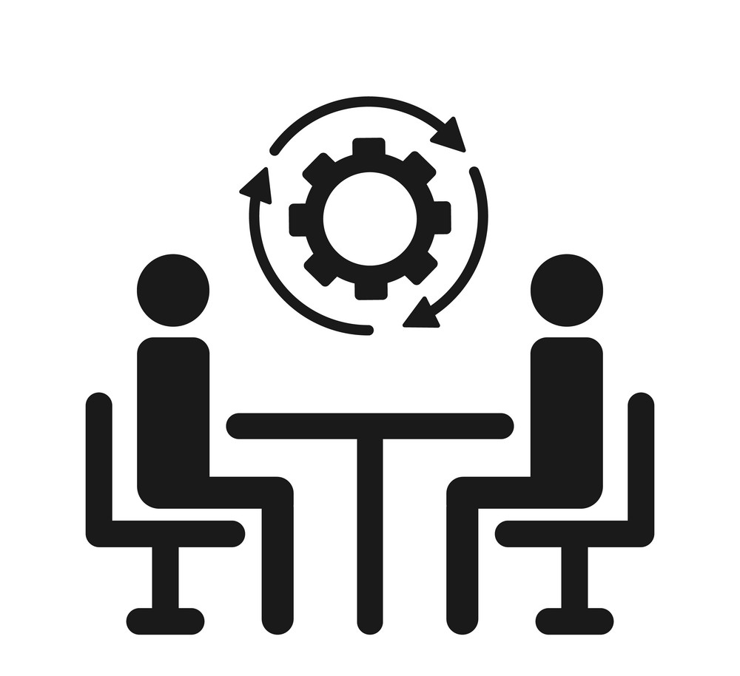
Culture
OBSERVATIONS
Culture drives action & success … always
Change is always hard – courage in the face of change is rewarded
Tech is changing how leaders lead, manage, and run organizations
There’s no monopoly on good ideas – cognitive diversity is rewarded
D&I is iterative & ongoing – there is no right answer or playbook
The grass is not always greener – DoD should give itself more credit
Industry willing to work w/ employees to ensure work/life/family balance to retain talent
RECOMMENDATIONS
Ensure recruitment process prioritizes character/cultural values of candidates
Transparency – reevaluate & promote desired Service values (promote innovation)
Shift from risk averse to risk management mentality – acknowledge that not all failures are failures
Rebuild culture of people first: employee well-being, increased attention to mental health/mindfulness, work/life/family balance
Demonstrate org trust by normalizing small/incremental wins

Slide 7
SDEF Recommendations
STRATEGIC PARTNERSHIPS
Ensure SDEF corporate sponsors are informed on DoD imperatives/Nat’l security objectives to ensure meaningful experiences
Treat corporate sponsors as potential extensions to the Nat’l security apparatus
Additional training – innovation hubs (AFWERX, NAVWERX), specific Service priorities
Exchange tours – expand DoD Public-Private Talent Exchange Programs
PROFESSIONAL DEVELOPMENT
Create a pool of GOFO mentors who have interest in the strategic partnerships to support professional development & advancement of Departmental interests
Budget for Fellows to attend Departmental/Service industry days (i.e. IWEPTAC) and/or innovation conferences to support advancing shared exposure to the operational challenges
Incorporate “Industry Days” into Senior Service College curriculums
LEVERAGING CONTRIBUTIONS
Recruit fellows to serve in utilization tours with OSD/JS following the SDEF program
Identify critical OSD/JS/Service innovation billets for follow-ons
Greater Fellow attribute awareness – maximize benefits for both fellow & company

